Slide 1
UNIX
Introduction

Slide 2
Module objectives
After completing this module you will be able to:
Explain what an Operating System is
List the major components of UNIX
Log in and Log out of a UNIX system
Be able to configure the connection settings
Describe the general format of UNIX commands
Use the UNIX help facility

Slide 3
Operating Systems
Operating Systems
Versions of UNIX
Unix Architecture
Logging In & Out
Commands & Getting help

Slide 4
Operating Systems
What is an Operating System (OS)?
A program to run other programs on a computer
Responsible for managing software and hardware resources
Manages memory allocation
Manages I/O operations
Manages files
Controls computer peripherals

Slide 5
Operating Systems
Characteristics of an Operating System
Multiuser
Allows multiple users to share use the computer relatively independently, that is not see each other’s files.
Multiprocessing / Multitasking
Allows multiple applications to run at the same time, even with just one cpu. The CPU switches so rapidly between processes it looks like they are all running simultaneously.
Multithreading
Allows a program to run on more than one CPU core at a time
Realtime
Ability to process and respond to input instantly. Almost imposible without specialised hardware.

Slide 6
Operating Systems
Operating Systems
Versions of UNIX
Unix Architecture
Logging In & Out
Commands & Getting help

Slide 7





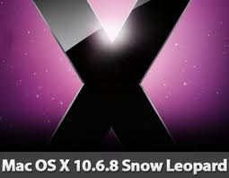

Versions of UNIX

Slide 8
Operating Systems
Operating Systems
Versions of UNIX
Unix Architecture
Logging In & Out
Commands & Getting help

Slide 9
Unix Architecture
Programs
Kernel
Hardware
Shell
Notes:
The inner most layer is the hardware, the kernel sits above the hardware and manages all hardware devices and controls programs which run on the computer
The kernel is loaded into memory at boot-up time and manages processes, the file system, memory. Essentially the kernel is the operating system.
The Shell is an interface program between the user and the kernel and is loaded into memory when the user logs on.
User will run programs from the shell.
User programs and utility programs interact with the kernel via system calls.

Slide 10
Unix Architecture
Unix OS
GUI
Shell
KDE
C csh
Bourne sh
Korn ksh
Bourne - Again bash
GNOME
LXDE
Xfce
Notes:
A windows-like graphical user interface and a command line shell offer different ways to interact with a unix OS.
The table list several different GUI’s and Shells
Unlike Microsoft Windows, which has a unique look and feel, there are many different GUIs available for Unix. Some of the more popular ones include KDE, Gnome, XFCE, LXDE, OpenBox, CDE, and Java Desktop
FDM’s Unix course is designed to interact with the Bourne – Again Shell, commonly referred to as the bash Shell
UNIX shells
There are 3 prominent and supported shells on most UNIX systems, the Bourne shell, Korn shell and the C shell. All of these behave in much the same way when running interactively, but have some difference in syntax and efficiency when used as scripting languages.
Linux shells
With a Linux installation you have access to the GNU shells and tools, the GNU Bourne again shell (Bash), the Linux default, is an enhanced Bourne shell. This is one of the most popular shells used.

Slide 11
Processes
How does Unix work?
Files
Files
Processes
daemons
Automatic
Directories
Input
Output
etc…
interactive
Notes:
In its simplest form everything in unix is either a file or a process.
A daemon, pronounced demon, is any background process that is activated by the occurrence of a specific event or condition.

Slide 12
Operating Systems
Operating Systems
Versions of UNIX
Unix Architecture
Logging In & Out
Commands & Getting help

Slide 13
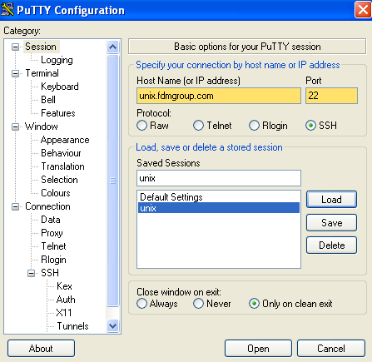
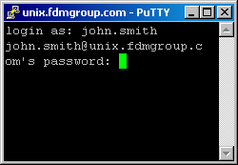
Logging In [using putty]
Notes:
Unix is a multi-user and multitasking system which means many users can access the system at the same time through different terminals and users can work on one task while another is being performed.
To connect to the FDM UNIX server, you need an SSH (Secure Shell) client such as PuTTY. Enter 'unix.fdmgroup.com' as the hostname and then enter your username and password when prompted.
PLEASE NOTE! When you type your password the characters will not be displayed
If this is a first time connection from that machine a security prompt will appear warning that the servers hosts key is not stored in the registry, on this occasion do not worry about this it is normal. Although with all security alerts you need to be certain any potential security breach.
You should save these settings to ensure they are always available.
Hitting yes will cache the key in the registry and you will not see this warning again on that particular machine.

Slide 14
Operating Systems
Operating Systems
Versions of UNIX
Unix Architecture
Logging In & Out
Commands & Getting help

Slide 15
Commands & Getting Help
Command –option(s) arg1 arg2 argN
ps
ps -f
ps –u judy
Command –option(s) arg1
Notes:
IMPORTANT!!!!!!
Options and arguments are all passed to the command as arguments, although options are preceded with a hyphen.
Irrespective whether they are options or arguments they are both separated by white space (this is important to remember and understand)
Options effect how the command runs and arguments are what the commands runs against

Slide 16

Questions?

